Slide 1
Machine Learning
Group 6
Names: NYIRASAMAZA Solange
MUHIRE Yvan Sebastien
NAIVE BAYES CLASSIFIER

Slide 2
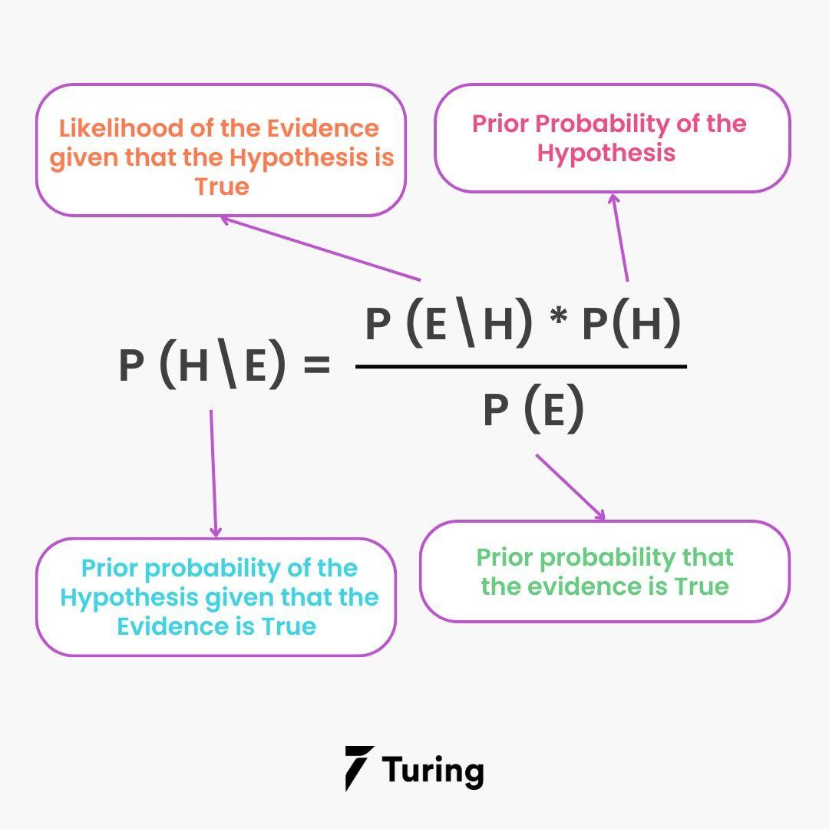
What is the Naive Bayes Algorithm?
It is an algorithm that learns the probability of every object, its features, and which groups they belong to. It is also known as a probabilistic classifier. The Naive Bayes Algorithm comes under supervised learning and is mainly used to solve classification problems.

Slide 3
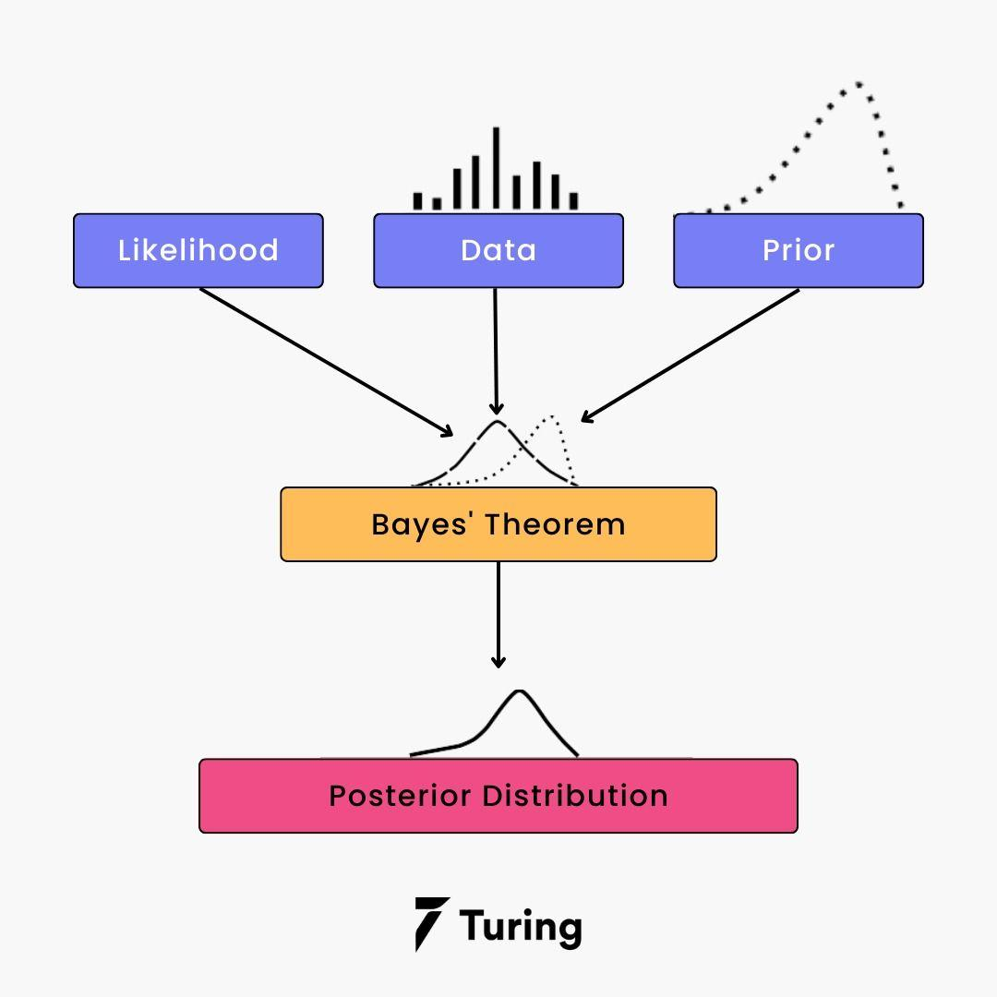
Bayes Theory from a machine learning standpoint
There are training data to train your model and make it functional. You then need to validate the data for evaluating the model and making new predictions. Finally, you need to call the input attributes “evidence” and label them “outputs” in the training data.

Slide 4
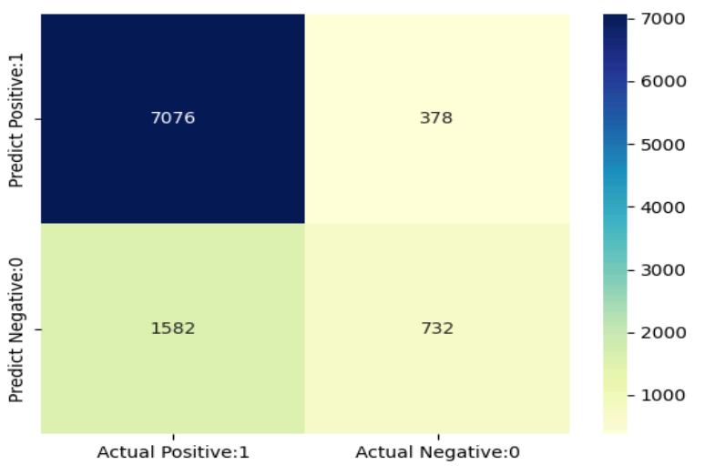
Confusion matrix
A confusion matrix is a table used in machine learning to evaluate the performance of a classification algorithm. It provides a summary of the number of correct and incorrect predictions made by the algorithm on a dataset.
True Positive (TP): 7076
True Negative (TN): 732
False Positive (FP): 378
False Negative (FN): 1582

Slide 5
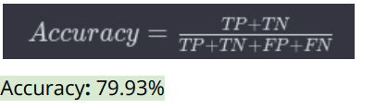
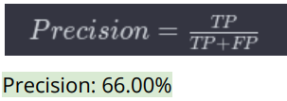
Model Evaluation
The code evaluates the model's performance using metrics such as confusion matrix, classification report, precision, recall, false positive rate, and specificity. These metrics provide insights into the model's ability to correctly classify instances and identify areas for improvement.
Key Metrics:
Accuracy: is the ratio of correctly predicted instances to the total instances
Precision: Is the ratio of correctly predicted positive observations to the total predicted positives.

Slide 6

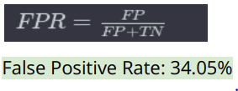
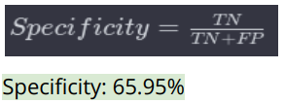
Cont’
Recall (Sensitivity): is the ratio of correctly predicted positive observations to the all observations in actual class.
False Positive Rate: Is the ratio of incorrectly predicted positive observations to the total actual negatives.
Specificity: Is the ratio of correctly predicted negative observations to the total actual negatives.

Slide 7
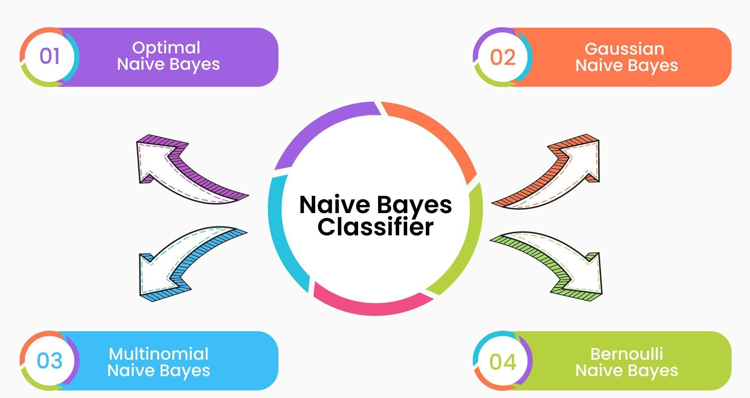
Types of the Naive Bayes Model

Slide 8
Cont’
Gaussian Naive Bayes
It is a straightforward algorithm used when the attributes present in the data should follow the rule of Gaussian distribution or normal distribution. It remarkably quickens the search, and under lenient conditions, the error will be two times greater than Optimal Naive Bayes.
Optimal Naive Bayer
Optimal Naive Bayes selects the class that has the greatest posterior probability of happenings. As per the name, it is optimal. But it will go through all the possibilities, which is very slow and time-consuming.

Slide 9
Cont’
Bernoulli Naive Bayes
Bernoulli Naive Bayes is an algorithm that is useful for data that has binary or boolean attributes. The attributes will have a value of yes or no, useful or not, granted or rejected.
Multinomial Naive Bayes
Multinomial Naive Bayes is used on documentation classification issues. The features needed for this type are the frequency of the words converted from the document..

Slide 10
Advantages of a Naive Bayes Classifier
Disadvantages of a Naive Bayes Classifier
● It doesn’t require larger amounts of training data.
● It is straightforward to implement.
● Convergence is quicker than other models, which are discriminative.
● It is used in real-time predictions.
● It will assume that all the attributes are independent, which rarely happens in real life. It will limit the application of this algorithm in real-world situations.
● It will estimate things wrong sometimes, so you shouldn’t take its probability outputs seriously.
● The Naive Bayes Algorithm has trouble with the ‘zero-frequency problem’. It happens when you assign zero probability for categorical variables in the training dataset that is not available. When you use a smooth method for overcoming this problem, you can make it work the best.

Slide 11
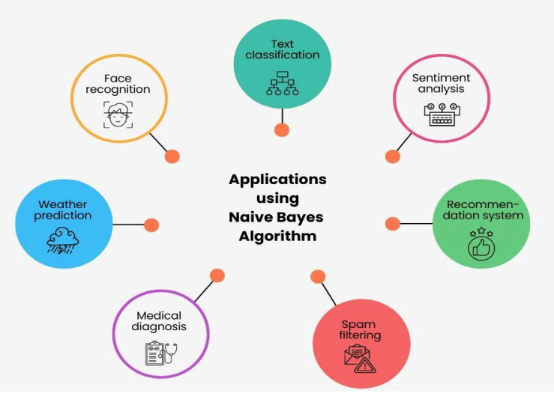
Applications that use Naive Bayes

Slide 12
THANK YOU!

